Slide 1


Slide 2
Beyond Sequential Consistency
C++Now 2025
May 1, 2025
Christopher Fretz
Senior C++ Engineer

Slide 3
Overview for this Talk
The goal is to discuss the different memory ordering models available in C++, along with performance differences of those models.
Starts with a quick introduction, defining terms and core concepts, before considering implementations and different memory models.
Considers an elegant lock-free data structure (queue) that is extremely favorable for memory ordering optimization.
Compares the relative performance of different memory models for this queue.
Considers surprising outcomes where atomics are not necessary.

Slide 4
Disclaimers
Lock-free programming is technically cool, but leads to complex solutions
Hard to get right, hard to maintain, hard to test
Often overused (do you really need it?)
Benchmark, benchmark, benchmark
Performance is often usage and hardware specific
This talk focuses on performance of the data structure itself, and chooses a data structure that optimizes well. Your mileage may vary.

Slide 5
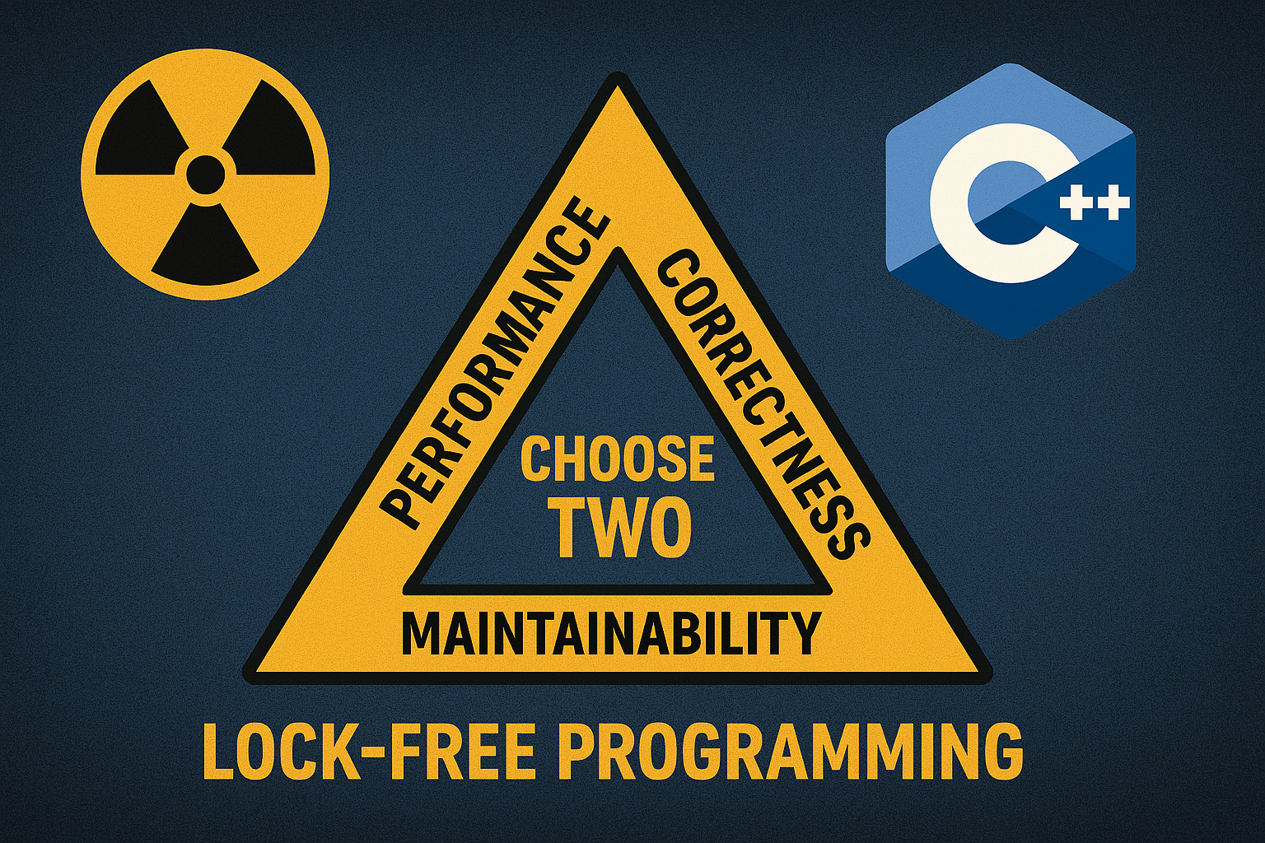
Image generated with ChatGPT 4o Image Gen

Slide 6
What Do We Mean by Lock-Free Programming?
Colloquially, avoiding the use of mutexes and system calls to synchronize.
Avoids software locks. Synchronization is still necessary.
Depends on hardware intrinsics that guarantee certain operations are “uninterruptible” or “atomic”.
More formally, lock freedom guarantees that at least one thread always makes progress.

Slide 7
What Do We Mean by Lock-Free Programming?
#include <mutex>
std::mutex m;
int counter {0};
// Bad, but illustrative code
void increment(int val) {
std::unique_lock l(m);
counter += val;
}

Slide 8
What Do We Mean by Lock-Free Programming?
#include <atomic>
std::atomic<int> counter {0};
// Bad, but illustrative code
void increment(int val) {
int prev = counter.load();
while (!counter.compare_exchange_strong(prev, prev + val)) {
// Back off, somebody else succeeded
}
}

Slide 9
What Do We Mean by Lock-Free Programming?
;; Traditional locked version
increment(int):
push rbx
mov ebx, edi
mov edi, OFFSET FLAT:m
call pthread_mutex_lock
test eax, eax
jne .L5
add DWORD PTR counter[rip], ebx
mov edi, OFFSET FLAT:m
pop rbx
jmp pthread_mutex_unlock
.L5:
mov edi, eax
call std::__throw_system_error(int)
;; Lock-free version
increment(int):
mov eax, DWORD PTR counter[rip]
.L2:
lea edx, [rdi+rax]
lock cmpxchg DWORD PTR counter[rip], edx
jne .L2
ret

Slide 10
What Do We Mean by Lock-Free Programming?
#include <atomic>
std::atomic<int> counter {0};
// Better version
void increment(int val) {
counter += val;
}
increment(int):
lock add DWORD PTR counter[rip], edi
ret

Slide 11
C++ Memory Model
Starting in C++11, we gained a formally defined memory model that includes multiple different “memory orderings”:
Relaxed
Acquire
Release
Acq/Rel
Sequentially Consistent

Slide 12
C++ Memory Model
Why all these different orderings? What is this for?
In a modern SMP machine, all cores are interacting with memory simultaneously
Each core has its own cache, meaning different cores may have independent copies of the same data
If operating on shared data, who sees which changes and at what time?
Do different cores even agree on the relative ordering of events?

Slide 13
C++ Memory Model
Why all these different orderings? What is this for?
The different orderings of the C++ memory model give fine grained control over this, and bring order to chaos
C++ defines an abstract memory model with several available orderings that give different guarantees about how different threads (cores) will observe events
Vendors and library authors leverage hardware-specific intrinsics to implement and uphold this model

Slide 14
“Fences” and “Barriers”
Modern machines and toolchains can reorder the execution of your code at build, link, and run time.
Optimizer may decide to reorder logically independent operations under the “as-if” rule.
CPU pipeline may decide to reorder instructions based on runtime data dependencies.
Cache coherency protocol (load/store buffers) may cause loads and stores to be observed in different orders by different threads/cores. Runtime order can appear to violate common-sense causality.

Slide 15
“Fences” and “Barriers”
“Memory fences” or “barriers” are the lowest order primitive used to constrain these reorderings.
Multiple types of fences:
Compiler fence: exists purely for the build toolchain, does not emit instructions. Prevents toolchain from reordering operations.
Runtime fence: runtime opcodes to constrain the CPU pipeline/memory subsystem. Prevents the hardware from reordering operations.

Slide 16
“Fences” and “Barriers”
“Memory fences” or “barriers” are the lowest order primitive used to constrain these reorderings.
Multiple types of fences:
Store fence: Forbids reordering of memory stores across the fence.
Load fence: Forbids reordered of memory loads across the fence.
Combined/full fence: Forbids any reordering across the fence.

Slide 17
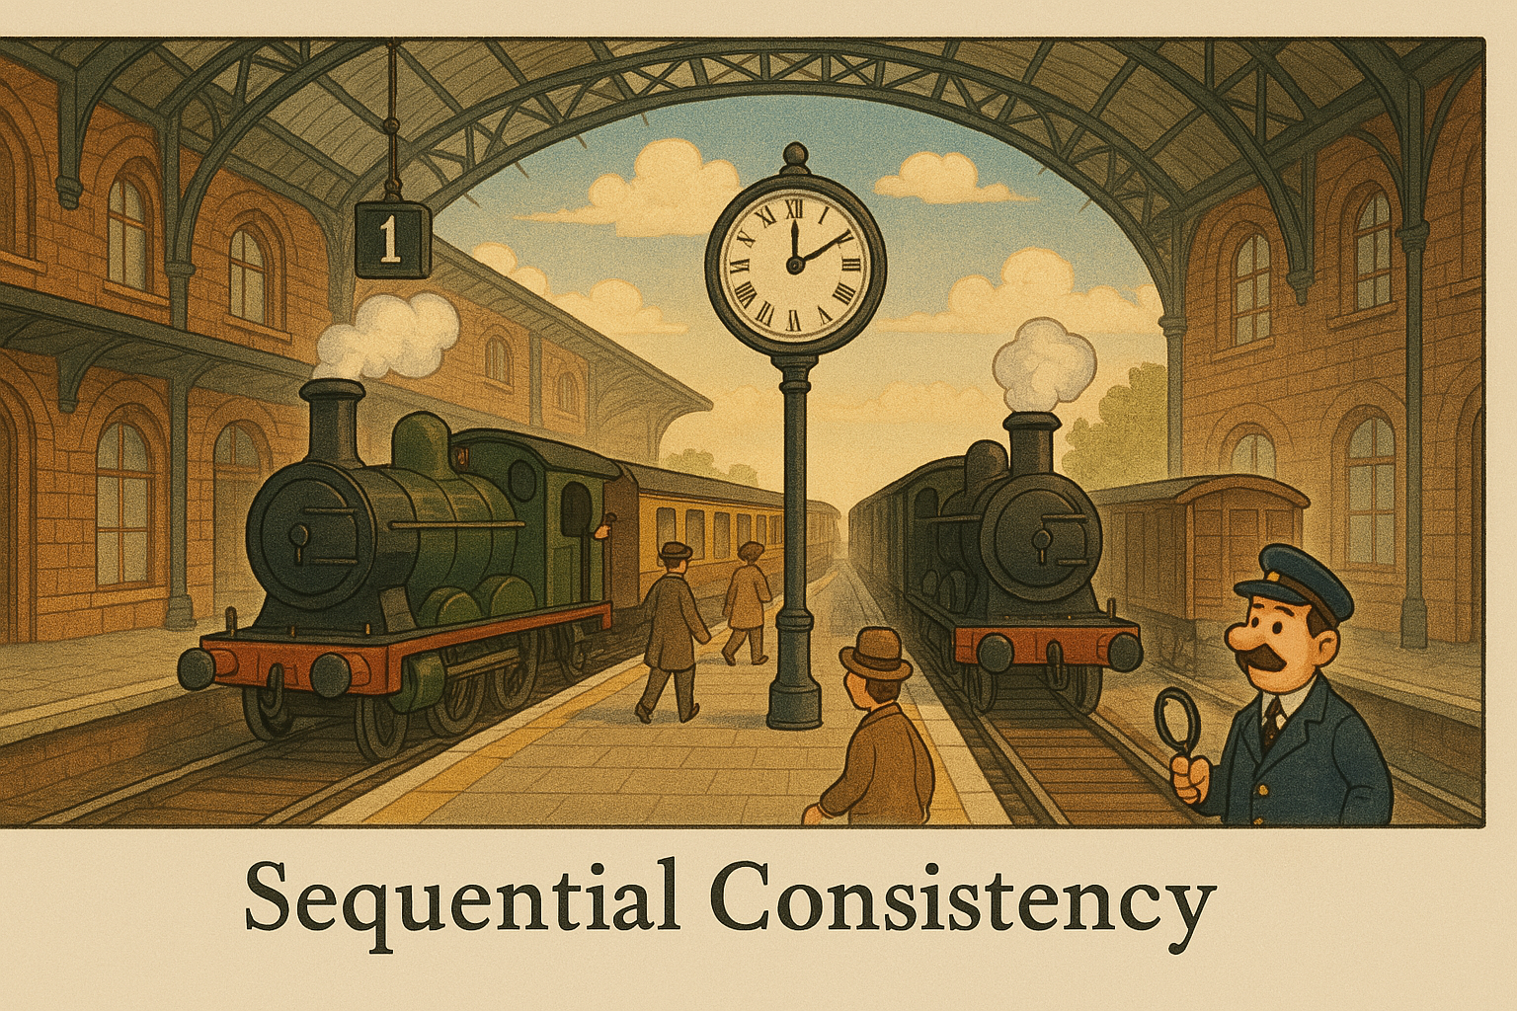
Image generated with ChatGPT 4o Image Gen

Slide 18
C++ Memory Model
Sequential Consistency
There exists a total ordering of all sequentially consistent operations that all threads agree upon.
Transitive visibility of operations is preserved; program appears to uphold expected causal relationships around all seq/cst operations, for all threads.
Default behavior.
Slowest behavior.

Slide 19
C++ Memory Model
#include <atomic>
#include <thread>
#include <vector>
std::atomic<int> a {0}, b {0}, c {0};
// Operations are atomic, and all threads agree on the order
// in which the increments happen, even between separate variables.
int main() {
std::vector<std::jthread> ts;
ts.emplace_back([] { ++a; ++b; ++c; }); // each increment issues a full fence
ts.emplace_back([] { ++b; ++c; ++a; }); // each increment issues a full fence
ts.emplace_back([] { ++c; ++a; ++b; }); // each increment issues a full fence
}

Slide 20
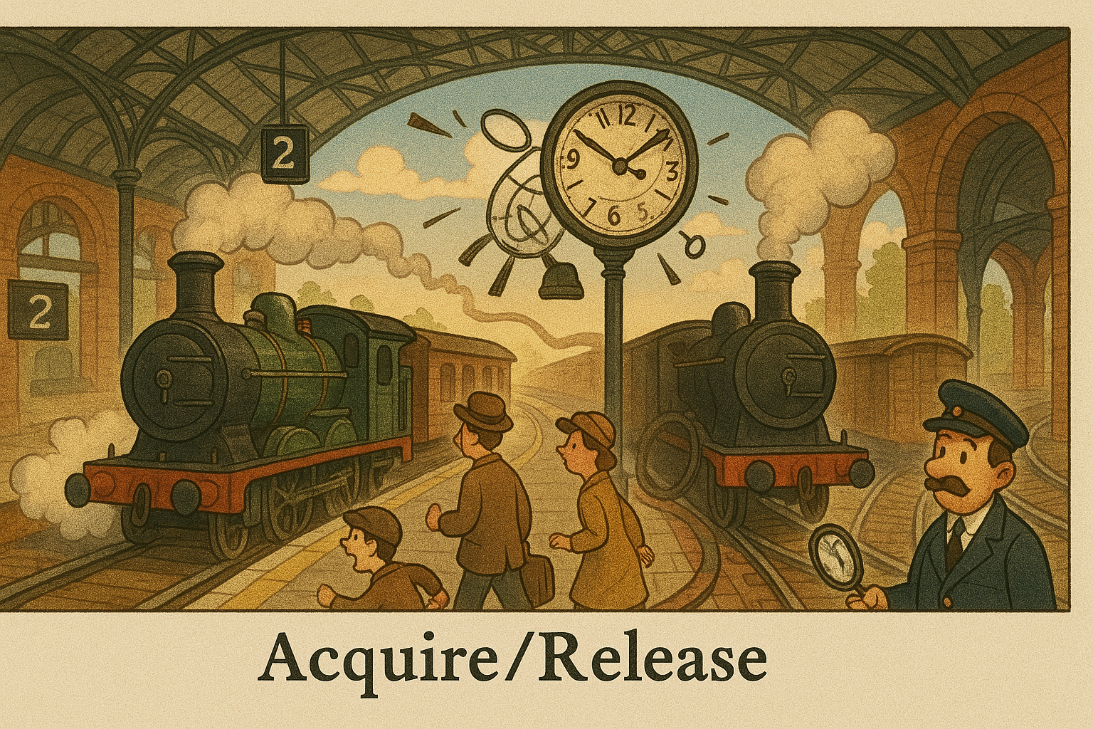
Image generated with ChatGPT 4o Image Gen

Slide 21
C++ Memory Model
Acquire/Release
Acquire/release usage on a specific atomic variable sets up a synchronization point between different threads.
If thread A stores into variable X with release ordering, and thread B loads that variable with acquire ordering, it is guaranteed that B can see all transitive stores that were visible to A at the time it made the store into X.
It is said that thread B “synchronizes with” thread A.
No guarantees are given for threads that don’t synchronize in this way.

Slide 22
C++ Memory Model
#include <atomic>
#include <cassert>
bool non_atomic = false;
std::atomic<bool> atomic {false};
void producer_thread() {
non_atomic = true;
atomic.store(true, std::memory_order::release); // Store fence. Store cannot move below this.
}
void consumer_thread() {
if (atomic.load(std::memory_order::acquire)) { // Load fence. Load cannot move above this.
assert(non_atomic); // Guaranteed if executed
}
}

Slide 23

Image generated with ChatGPT 4o Image Gen

Slide 24
C++ Memory Model
Relaxed
Only guarantees atomicity (no thread can see a partial write) and modification order
“Modification order” gives a total ordering of writes to that one variable
No guarantees whatsoever in terms of ordering or visibility with other reads/writes
Establishes neither a runtime fence nor a compiler barrier, and can therefore be reordered arbitrarily at compile or run time

Slide 25
C++ Memory Model
#include <atomic>
#include <iostream>
std::atomic<int> one {0}, two {0};
void thread_a() {
auto loadtwo = two.load(std::memory_order::relaxed);
one.store(loadtwo, std::memory_order::relaxed);
std::cout << "loadtwo is: " << loadtwo << std::endl;
}
void thread_b() {
auto loadone = one.load(std::memory_order::relaxed);
two.store(42, std::memory_order::relaxed);
std::cout << "loadone is: " << loadone << std::endl;
}
// => loadone is: 42
// => loadtwo is: 42
two.store(42, std::memory_order::relaxed);
auto loadone = one.load(std::memory_order::relaxed);

Slide 26
C++ Memory Model
#include <atomic>
#include <iostream>
std::atomic<int> one {0}, two {0};
void thread_a() {
auto loadtwo = two.load(std::memory_order::relaxed);
one.store(loadtwo, std::memory_order::relaxed);
std::cout << "loadtwo is: " << loadtwo << std::endl;
}
void thread_b() {
auto loadone = one.load(std::memory_order::relaxed);
two.store(42, std::memory_order::relaxed);
std::cout << "loadone is: " << loadone << std::endl;
}
// => loadone is: 42
// => loadtwo is: 42
void thread_b() {
two.store(42, std::memory_order::relaxed);
auto loadone = one.load(std::memory_order::relaxed);
std::cout << "loadone is: " << loadone << std::endl;
}
void thread_a() {
auto loadtwo = two.load(std::memory_order::relaxed);
one.store(loadtwo, std::memory_order::relaxed);
std::cout << "loadtwo is: " << loadtwo << std::endl;
}
two.store(42, std::memory_order::relaxed);
auto loadone = one.load(std::memory_order::relaxed);

Slide 27
C++ Memory Model
Relaxed
Gives the implementation total freedom to reoder at any (or multiple) level.
Gives the programmer very little ability to reason about causal relationships.

Slide 28
A Practical Lock-Free Data Structure
“Prototypical example” that is also extraordinarily useful, elegant, and fast
A lock-free ring buffer uses a circular buffer of memory, along with atomic counters, to move data between threads
Basic use case is single producer/single consumer; can be trivially extended to single producer/multiple consumer

Slide 29
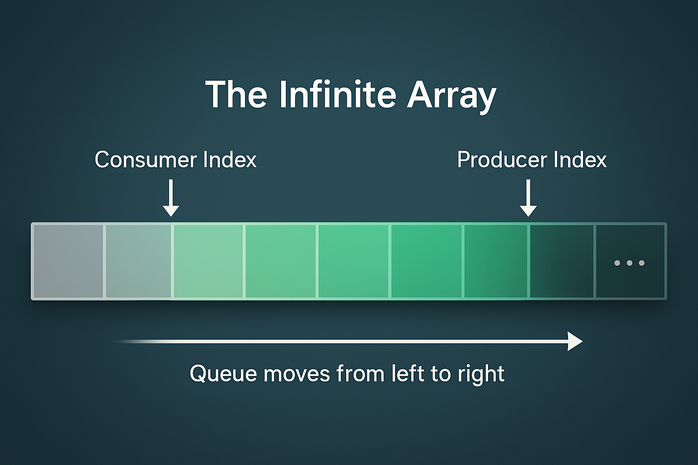
Image generated with ChatGPT 4o Image Gen

Slide 30
A Practical Lock-Free Data Structure
In the “infinite array” concept, a queue is trivially implemented using two atomic counters: a producer index and a consumer index
Enqueues are performed by copying data into the array and incrementing the producer index
Dequeues are performed by copying data out of the array and incrementing the consumer index
Indexes increase monotonically

Slide 31
Image generated with ChatGPT 4o Image Gen

Slide 32
A Practical Lock-Free Data Structure
In practice, we only have access to finite memory, but the design can be trivially adapted
Queue maintains two atomic counters: a producer index and a consumer index
Counters are indexes into the “infinite” array, but modular arithmetic maps them into a finite buffer
Buffer is used circularly, wrapping back around to the beginning from the end

Slide 33
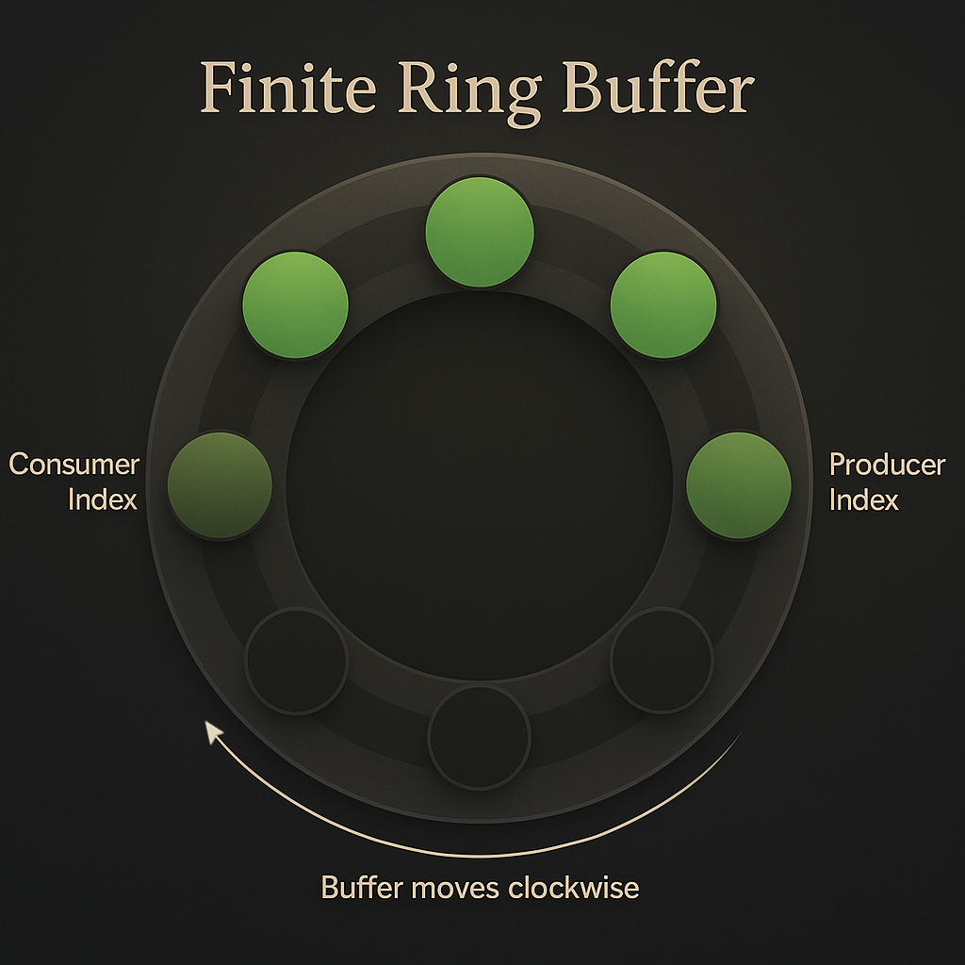
Image generated with ChatGPT 4o Image Gen

Slide 34
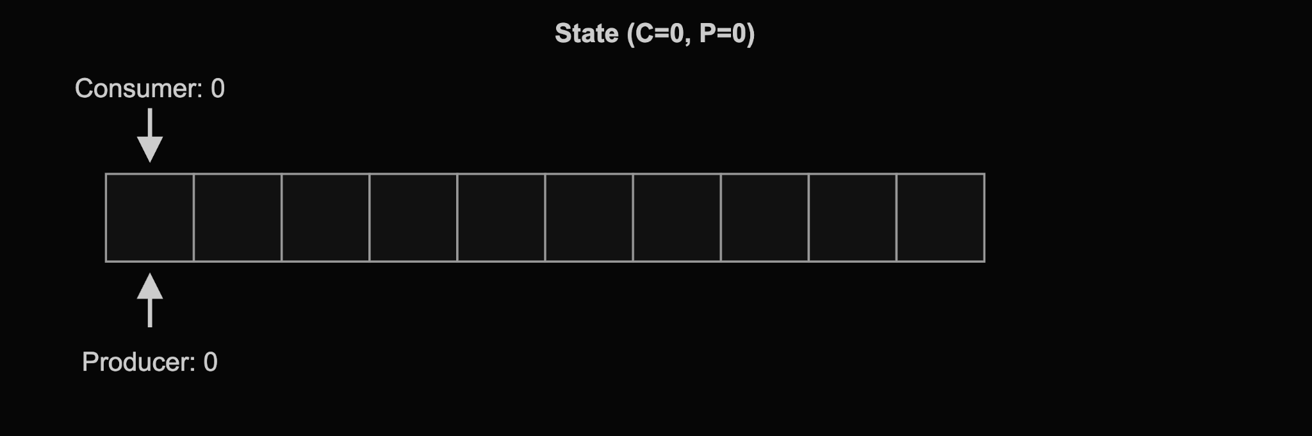
Image generated with ChatGPT 4o Image Gen

Slide 35
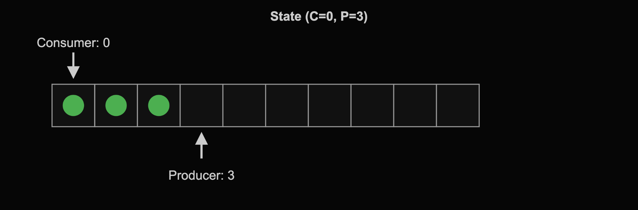
Image generated with ChatGPT 4o Image Gen

Slide 36
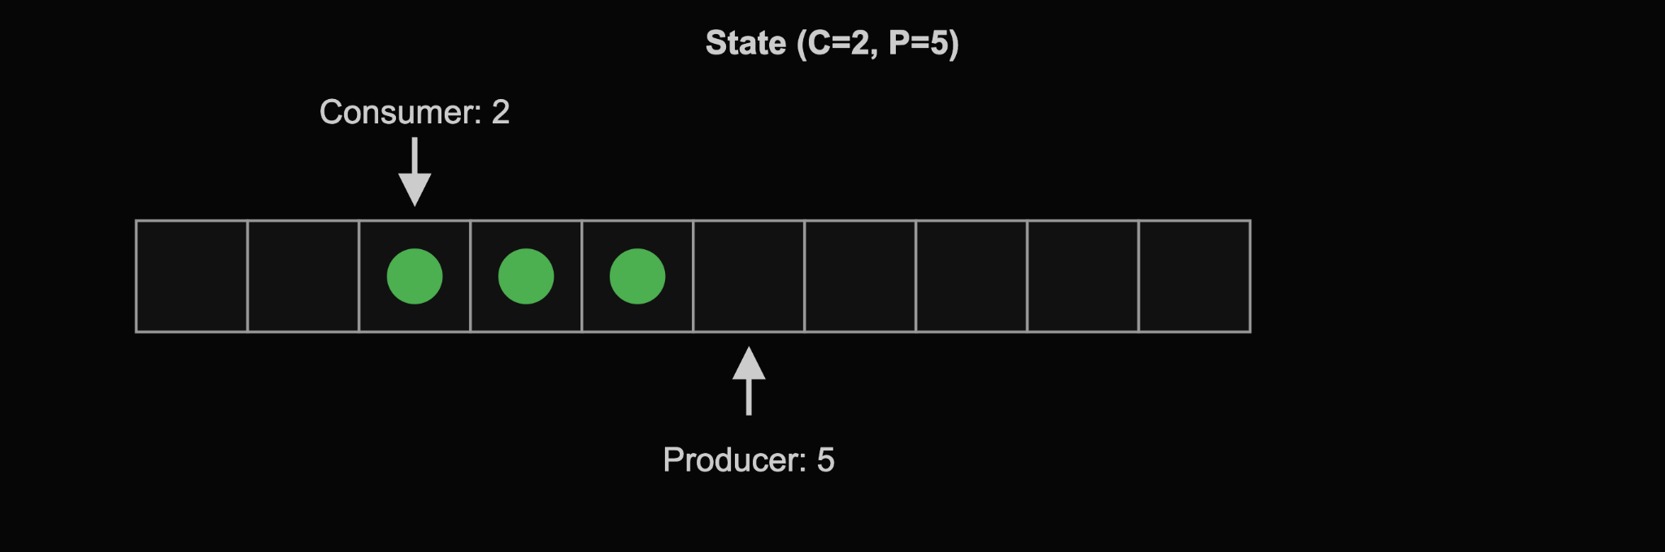
Image generated with ChatGPT 4o Image Gen

Slide 37
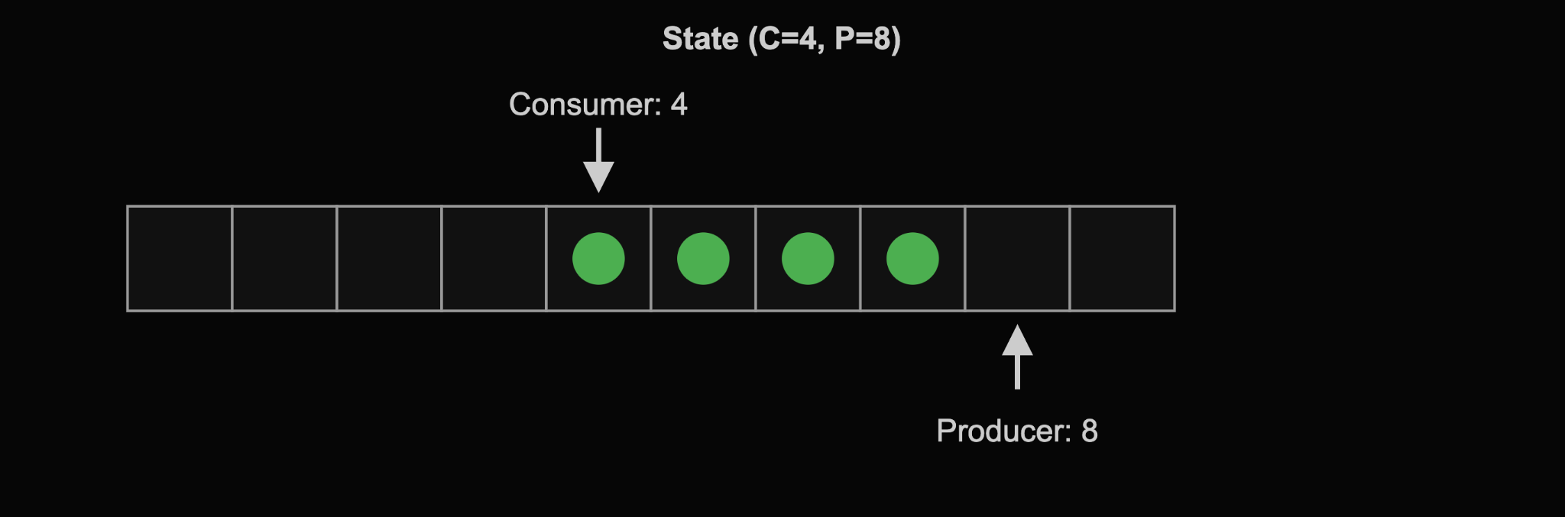
Image generated with ChatGPT 4o Image Gen

Slide 38
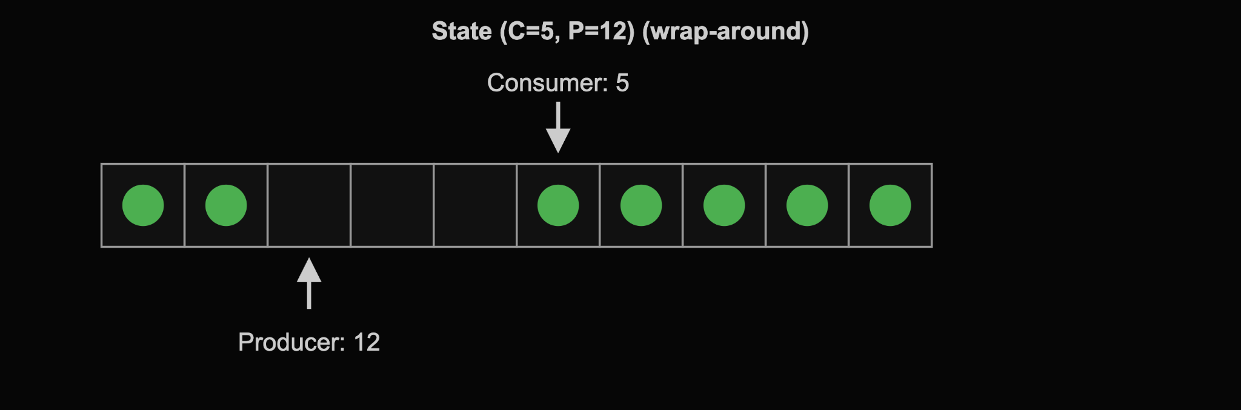
Image generated with ChatGPT 4o Image Gen

Slide 39
A Practical Lock-Free Data Structure
void producer(ring_buffer* queue) {
int64_t counter = 0;
while (counter < 10'000'000'000) {
queue->push(counter);
++counter;
}
}
void consumer(ring_buffer* queue) {
int64_t counter = 0;
while (counter < 10'000'000'000) {
auto val = queue->pop();
assert(val == counter);
++counter;
}
}

Slide 40
A Practical Lock-Free Data Structure
struct ring_buffer { // Would be a class template in real code
static constexpr std::size_t capacity = 32'768;
ring_buffer() : next_producer_record(0), next_consumer_record(0) {}
inline void push(int64_t record) noexcept;
inline int64_t pop() noexcept;
inline std::size_t size() const noexcept;
inline void sleep(std::size_t& spin_counter) const noexcept;
inline std::size_t map_index(std::size_t index) const noexcept;
std::atomic<std::size_t> next_producer_record;
std::atomic<std::size_t> next_consumer_record;
std::array<int64_t, capacity> data;
};

Slide 41
A Practical Lock-Free Data Structure
inline void ring_buffer::push(int64_t record) noexcept {
// Wait until there's space
std::size_t spin_counter = 0;
while (size() == capacity) sleep(spin_counter);
// Produce the record
data[map_index(next_producer_record)] = record;
++next_producer_record;
}
inline std::size_t ring_buffer::size() const noexcept {
return next_producer_record - next_consumer_record;
}
inline std::size_t ring_buffer::map_index(std::size_t index) const noexcept {
return index % capacity; // Could be a bitmask
}

Slide 42
A Practical Lock-Free Data Structure
inline int64_t ring_buffer::pop() noexcept {
// Wait until there's data
std::size_t spin_counter = 0;
while (!size()) sleep(spin_counter);
// Consume the record
auto record = data[map_index(next_consumer_record)];
++next_consumer_record;
return record;
}
inline void ring_buffer::sleep(std::size_t& spin_counter) const noexcept {
using namespace std::chrono_literals;
if (spin_counter++ < 16) return;
else std::this_thread::sleep_for(50us);
}

Slide 43
A Practical Lock-Free Data Structure
void print_stats(ring_buffer const* queue) {
std::size_t prev_idx = 0;
while (runflag) {
std::size_t new_idx = queue->next_consumer_record;
std::cout << "Queue is moving at " << (new_idx - prev_idx) << " records/second." << std::endl;
std::this_thread::sleep_for(1s);
prev_idx = new_idx;
}
}
int main() {
auto queue = std::make_unique<ring_buffer>();
std::thread stats {print_stats, queue.get()}, prod {producer, queue.get()}, cons {consumer, queue.get()};
prod.join(); cons.join();
runflag = false; stats.join();
}

Slide 44
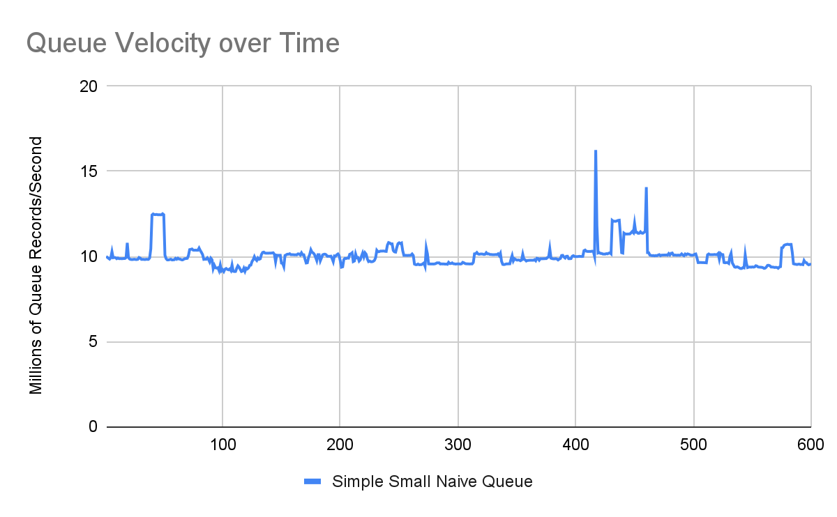

Slide 45
Performance Analysis
Roughly ten million queue records per second might sound like a lot, but it’s really not
At 2.6 Ghz, 10 million records/second means we’re at ~260 cycles per record
Our queue is doing absolutely no work, and it’s moving integers
We should be able to go substantially faster
What gives?

Slide 46
Performance Analysis
inline void
ring_buffer::push(int64_t record) noexcept {
// Wait until there's space
std::size_t spin_counter = 0;
while (size() == capacity)
sleep(spin_counter);
// Produce the record
data[map_index(next_producer_record)] = record;
++next_producer_record;
}
.L40:
add rbx, 1 ;; incr spin count
.L45:
mov rax, QWORD PTR [rbp+0] ;; producer index load
mov rdx, QWORD PTR [r12] ;; consumer index load
sub rax, rdx ;; get queue size
cmp rax, 32768 ;; queue capacity check
jne .L48 ;; space in the queue
cmp rbx, 15 ;; spinlock counter check
jbe .L40 ;; keep spinning
;; ...setup for nanosleep...
.L42:
call nanosleep ;; backoff

Slide 47
Performance Analysis
inline void
ring_buffer::push(int64_t record) noexcept {
// Wait until there's space
std::size_t spin_counter = 0;
while (size() == capacity)
sleep(spin_counter);
// Produce the record
data[map_index(next_producer_record)] = record;
++next_producer_record;
}
.L48:
mov rax, QWORD PTR [rbp+0] ;; prod index load
and eax, 32767 ;; map queue index
mov QWORD PTR [rbp+16+rax*8], r13 ;; store in queue
lock add QWORD PTR [rbp+0], 1 ;; incr prod index
add r13, 1 ;; incr next record

Slide 48
Performance Analysis
inline int64_t ring_buffer::pop() noexcept {
// Wait until there's data
std::size_t spin_counter = 0;
while (!size()) sleep(spin_counter);
// Consume the record
auto record = data[map_index(next_consumer_record)];
++next_consumer_record;
return record;
}
.L13:
add rbx, 1 ;; incr spin count
.L19:
mov rdx, QWORD PTR [r12] ;; producer index load
mov rax, QWORD PTR [rbp+0] ;; consumer index load
cmp rdx, rax ;; is data in queue
jne .L22 ;; data is in queue
cmp rbx, 15 ;; spinlock counter check
jbe .L13 ;; keep spinning
;; ...setup for nanosleep...
.L15:
call nanosleep ;; backoff

Slide 49
Performance Analysis
inline int64_t ring_buffer::pop() noexcept {
// Wait until there's data
std::size_t spin_counter = 0;
while (!size()) sleep(spin_counter);
// Consume the record
auto record = data[map_index(next_consumer_record)];
++next_consumer_record;
return record;
}
.L22:
mov rax, QWORD PTR [rbp+0] ;; cons index load
and eax, 32767 ;; map queue index
mov rax, QWORD PTR [r12+16+rax*8] ;; load rec from q
lock add QWORD PTR [rbp+0], 1 ;; incr cons index
cmp rax, r13 ;; assertion check
jne .L23 ;; failed assertion
add r13, 1 ;; predict next rec

Slide 50
Performance Analysis
The only potential bottleneck in the assembly is the lock add instruction
This is a read-modify-write instruction and issues a full memory fence
Do we really need this?

Slide 51
The Cost of Operators
By using the default API on std::atomic (operators), we are implicitly requesting full sequential consistency.
By using the pre-increment operator, we are implicitly requesting the read-modify-write (fetch add).
The producer and consumer are individually single threaded, and our access pattern doesn’t require sequential consistency.
We can avoid both.

Slide 52
Atomic Optimization
inline void ring_buffer::push(int64_t record) noexcept {
// Wait until there's space
std::size_t spin_counter = 0;
std::size_t producer = next_producer_record.load(std::memory_order::acquire);
while (!has_space(producer)) sleep(spin_counter);
// Produce the record
data[map_index(producer)] = record;
next_producer_record.store(producer + 1, std::memory_order::release);
}
inline bool ring_buffer::has_space(std::size_t producer) const noexcept {
std::size_t consumer = next_consumer_record.load(std::memory_order::acquire);
if (producer - consumer < capacity) return true;
else return false;
}

Slide 53
Atomic Optimization
inline int64_t ring_buffer::pop() noexcept {
// Wait until there's data
std::size_t spin_counter = 0;
std::size_t consumer = next_consumer_record.load(std::memory_order::acquire);
while (!has_data(consumer)) sleep(spin_counter);
// Consume the record
auto record = data[map_index(consumer)];
next_consumer_record.store(consumer + 1, std::memory_order::release);
return record;
}
inline bool ring_buffer::has_data(std::size_t consumer) const noexcept {
std::size_t producer = next_producer_record.load(std::memory_order::acquire);
if (producer - consumer != 0) return true;
else return false;
}

Slide 54
Atomic Optimization
inline void
ring_buffer::push(int64_t record) noexcept {
// Wait until there's space
std::size_t spin_counter = 0;
std::size_t producer =
next_producer_record.load(
std::memory_order::acquire);
while (!has_space(producer))
sleep(spin_counter);
// Produce the record
data[map_index(producer)] = record;
next_producer_record.store(
producer + 1, std::memory_order::release);
}
.L49:
mov rbx, QWORD PTR [r12] ;; producer index load
xor r15d, r15d ;; sleep counter reset
.L45:
mov rdx, QWORD PTR [r13+0] ;; consumer index load
mov rax, rbx
sub rax, rdx ;; get records in queue
cmp rax, 32767 ;; queue capacity check
jbe .L59 ;; space is available
cmp r15, 15 ;; spinlock counter check
jbe .L51 ;; we are still spinning
;; ...setup for nanosleep call...
.L47:
call nanosleep ;; backoff
;; ...error handling for nanosleep...
.L51:
add r15, 1 ;; incr spin count
jmp .L45

Slide 55
Atomic Optimization
inline void
ring_buffer::push(int64_t record) noexcept {
// Wait until there's space
std::size_t spin_counter = 0;
std::size_t producer =
next_producer_record.load(
std::memory_order::acquire);
while (!has_space(producer))
sleep(spin_counter);
// Produce the record
data[map_index(producer)] = record;
next_producer_record.store(
producer + 1, std::memory_order::release);
}
jmp .L49 ;; entrypoint
.L59:
mov rax, rbx ;; backup prod index
add rbx, 1 ;; incr prod index
and eax, 32767 ;; map queue index
mov QWORD PTR [r12+16+rax*8], rbp ;; store rec in queue
add rbp, 1 ;; incr current record
mov QWORD PTR [r12], rbx ;; update prod index
cmp rbp, r14 ;; completion check
je .L58 ;; producer terminates
.L49:
mov rbx, QWORD PTR [r12] ;; load producer index
xor r15d, r15d ;; from previous slide

Slide 56
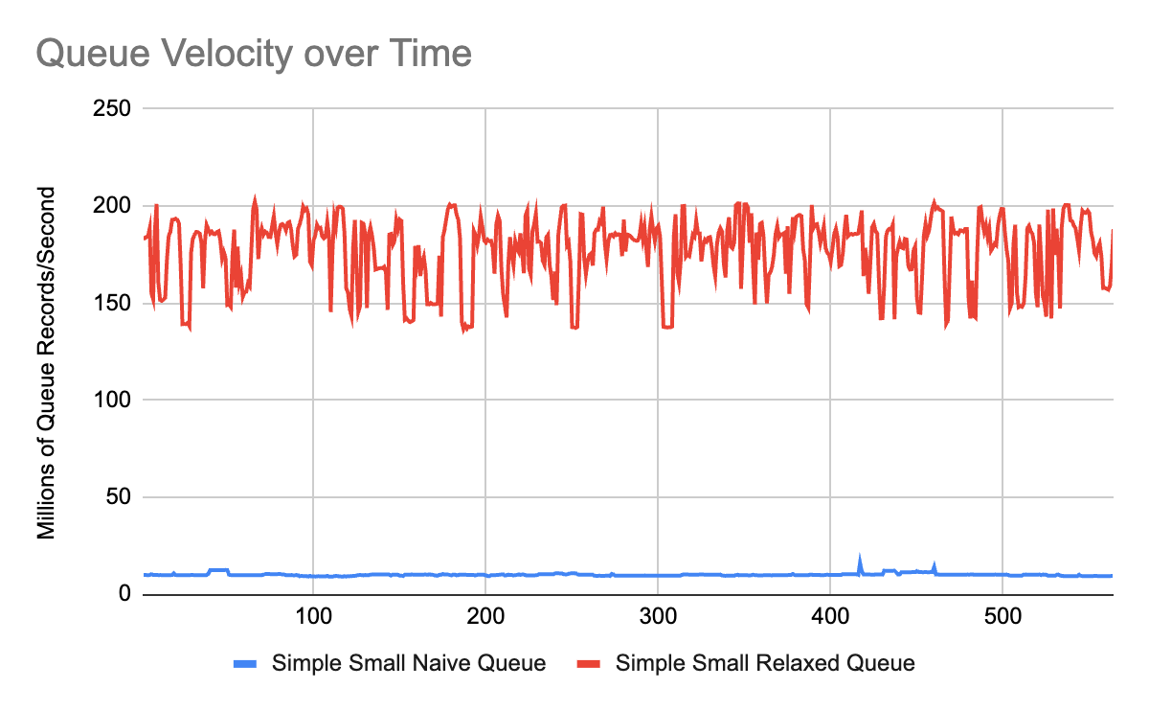

Slide 57
Performance Analysis
New code has literally zero atomic instructions or fences on x86_64
At 2.6 Ghz, 170 million records/second is ~15 cycles per record
Are these numbers too good?
Test machine has 32K of L1 cache, 1 MB of L2 cache; Queue contains only integers: entire thing fits in L2, about ⅛ fits in L1
Too small to be realistic, but shows what the hardware is capable of
Can we still go faster?

Slide 58

Image generated with ChatGPT 4o Image Gen

Slide 59
Next Bottleneck
struct ring_buffer { // Would be a class template in real code
static constexpr std::size_t capacity = 32'768;
ring_buffer() : next_producer_record(0), next_consumer_record(0) {}
inline void push(int64_t record) noexcept;
inline int64_t pop() noexcept;
inline std::size_t size() const noexcept;
inline void sleep(std::size_t& spin_counter) const noexcept;
inline std::size_t map_index(std::size_t index) const noexcept;
std::atomic<std::size_t> next_producer_record; // sizeof(next_producer_record) == 8
std::atomic<std::size_t> next_consumer_record; // both indexes on the same cache line
std::array<int64_t, capacity> data;
};

Slide 60
Next Bottleneck
Current memory layout packs the producer index and consumer index directly next to each other; they likely fall on the same cache line.
Different cores will fight to modify the same line concurrently.
Cache lines are the minimum granularity for most memory subsystems.
MESI cache protocol will require bouncing the line back and forth.
std::hardware_destructive_interference_size exists to solve this.

Slide 61
Next Bottleneck
struct ring_buffer { // Would be a class template in real code
static constexpr std::size_t capacity = 32'768;
static constexpr std::size_t cache_line_size = std::hardware_destructive_interference_size;
ring_buffer() : next_producer_record(0), next_consumer_record(0) {}
inline void push(int64_t record) noexcept;
inline int64_t pop() noexcept;
inline bool has_space(std::size_t producer) const noexcept;
inline bool has_data(std::size_t consumer) const noexcept;
inline void sleep(std::size_t& spin_counter) const noexcept;
inline std::size_t map_index(std::size_t ptr) const noexcept;
alignas(cache_line_size) std::atomic<std::size_t> next_producer_record; // record is now 64 bytes
alignas(cache_line_size) std::atomic<std::size_t> next_consumer_record; // guaranteed unique lines
alignas(cache_line_size) std::array<int64_t, capacity> data;
};

Slide 62
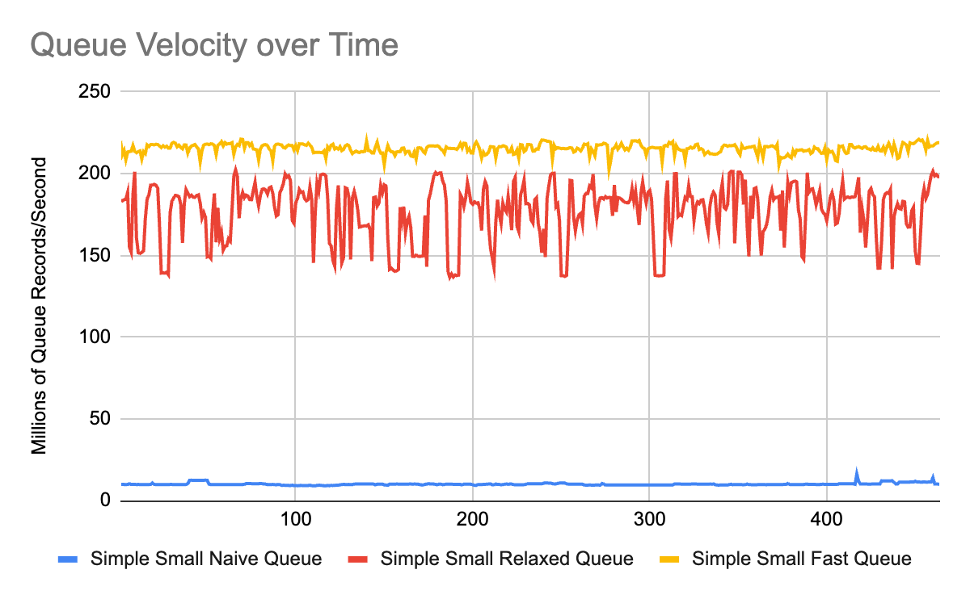

Slide 63
Next Steps
HUGE difference (over 20x when aligned) using different memory orderings!
Queue is too trivial to be realistic
How can we make benchmark more realistic?
First step: See how performance trends as data gets larger

Slide 64
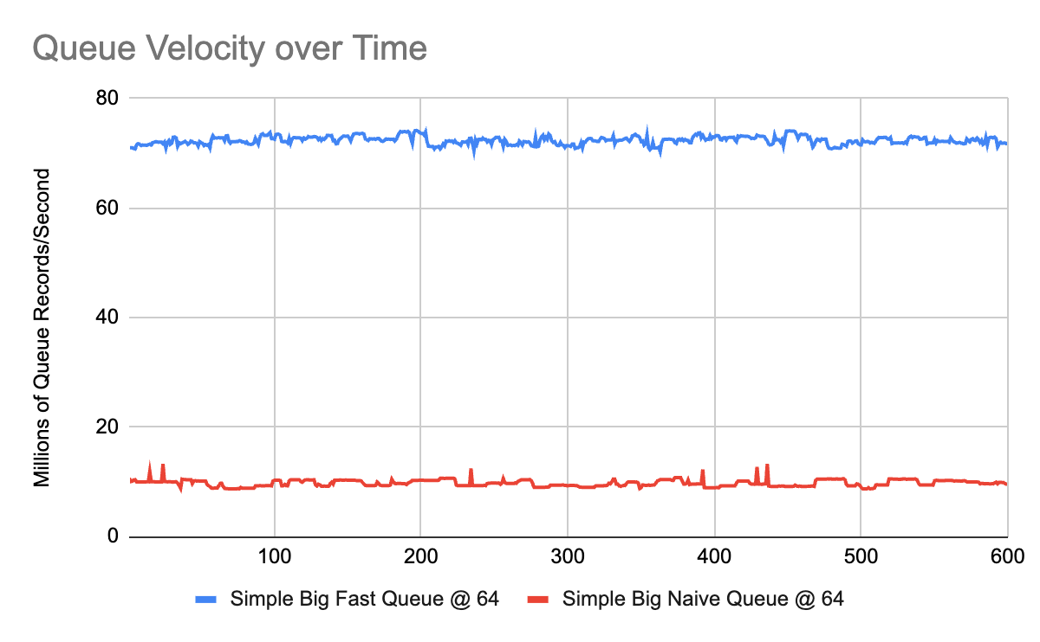

Slide 65
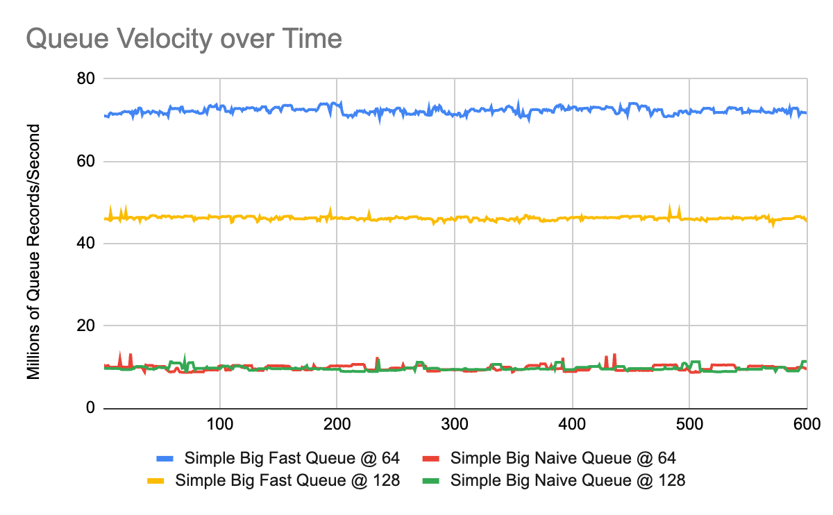

Slide 66
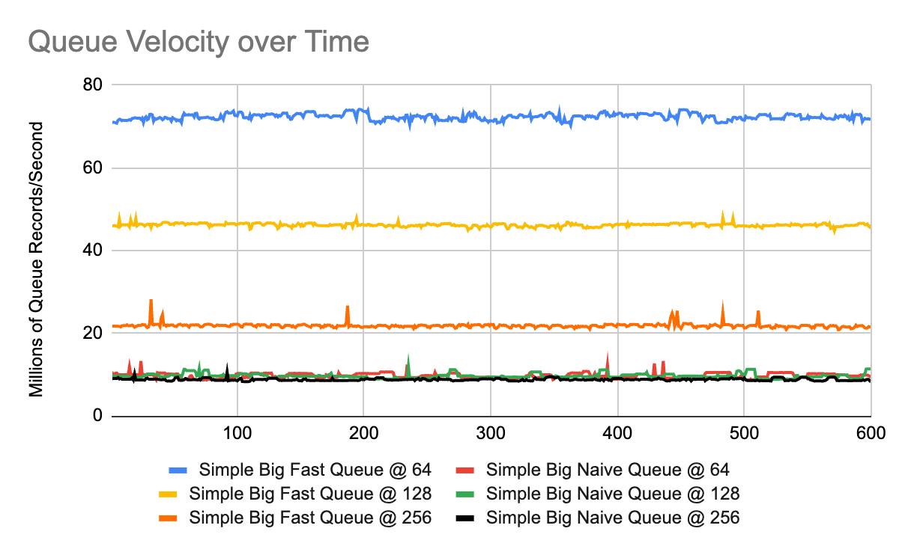

Slide 67
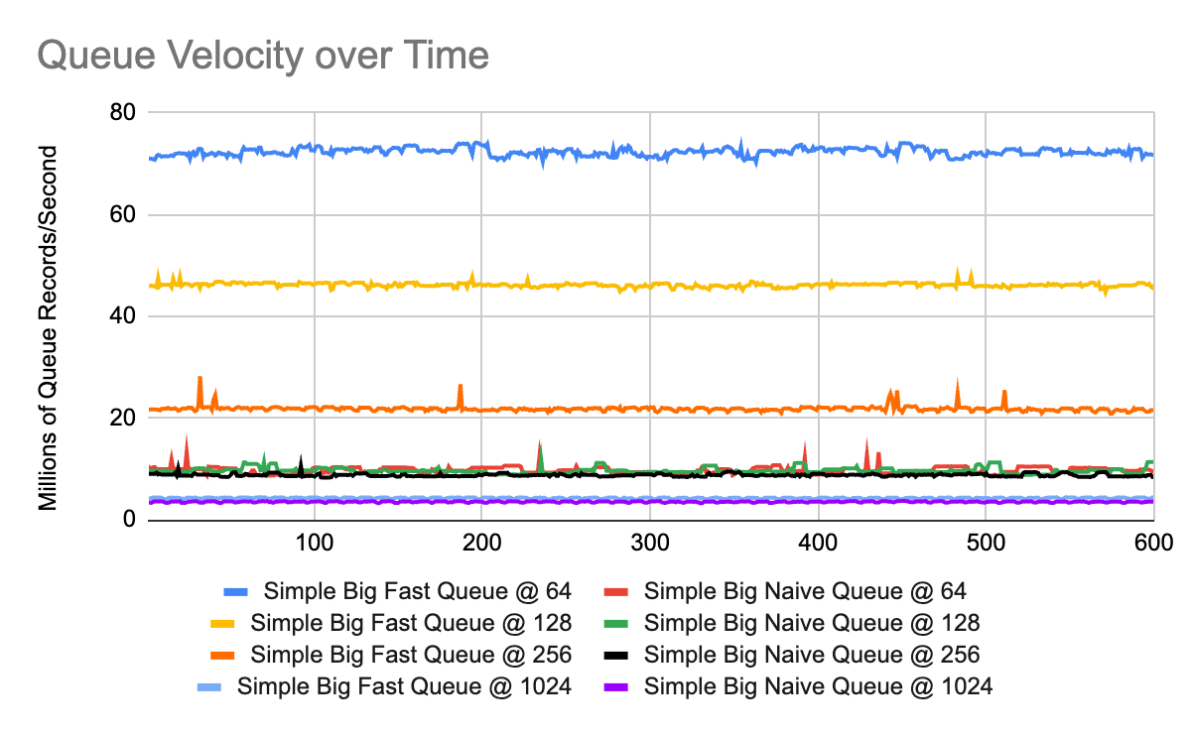

Slide 68
Next Steps
Even at substantially larger data sizes, performance diff is durable
Have to go to 1024 bytes before copy is the dominating factor over synchronization
Even in this case, we still save ~25%
How else can we make this more realistic?

Slide 69
Multi-Consumer Broadcast Queue
A traditional “work queue” divides incoming data between a pool of cooperating threads.
In a broadcast queue, by contrast, all consumer threads receive all data.
Each consumer maintains its own individual queue index.
Useful in workflows like semantic analysis, intrusion detection, classification, etc, where many different things need to be done on each data record.
Think of it like Kafka, except entirely in-memory and lock-free.

Slide 70
Multi-Consumer Broadcast Queue
Multiple consumers adds a new problem, how does the producer know if the queue is full?
Need to add a new thread, whose job is to identify the “slowest consumer”.
Let’s call this new thread the “collector”.
The “collector” continuously observes the consumer indexes and identifies the slowest consumer in the queue (lowest index), which it records as its own index, and becomes the new “edge” of the circular buffer.

Slide 71
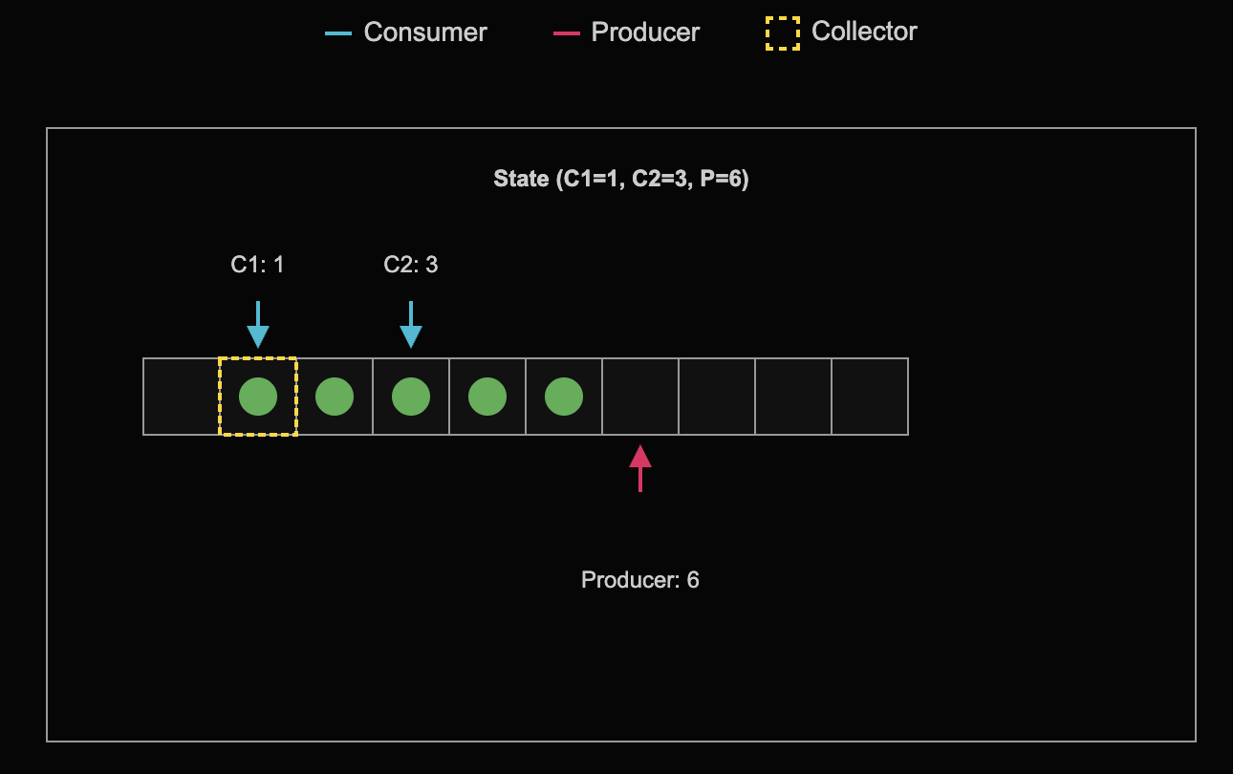
Image generated with ChatGPT 4o Image Gen

Slide 72
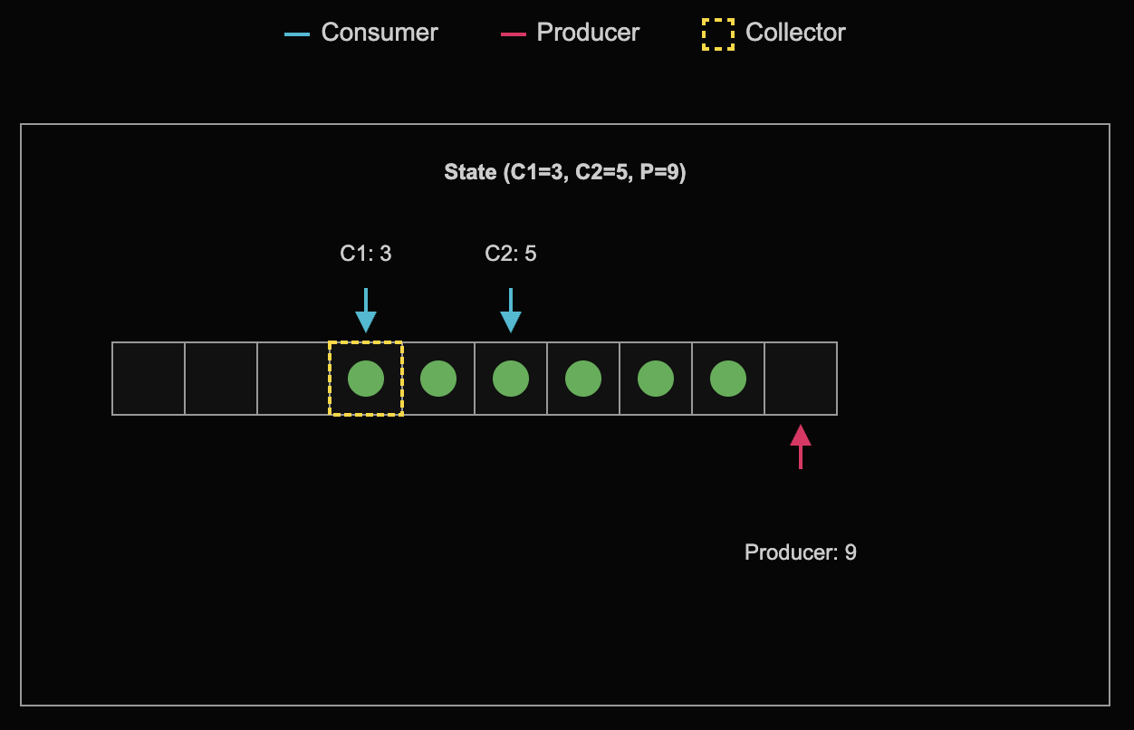
Image generated with ChatGPT 4o Image Gen

Slide 73
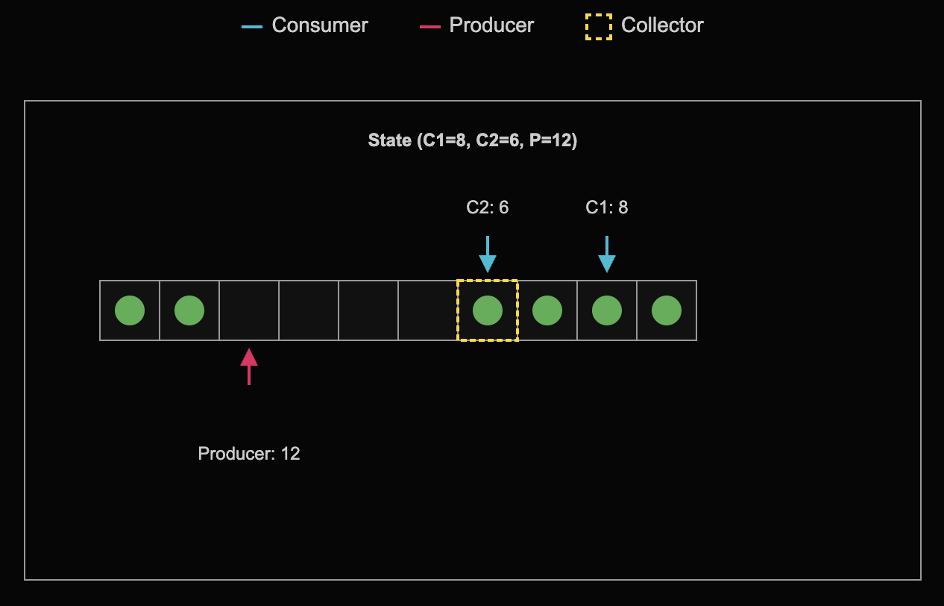
Image generated with ChatGPT 4o Image Gen

Slide 74
Multi-Consumer Broadcast Queue
struct ring_buffer { // Would be a class template in real code
struct alignas(cache_line_size) consumer_ctxt {
consumer_ctxt() : next_consumer_record(0) {}
std::atomic<std::size_t> next_consumer_record;
};
ring_buffer() : next_producer_record(0), slowest_consumer_record(0) {}
inline void push(int64_t record) noexcept;
inline int64_t pop(std::size_t id) noexcept;
inline void collect() noexcept;
alignas(cache_line_size) std::atomic<std::size_t> next_producer_record;
alignas(cache_line_size) std::atomic<std::size_t> slowest_consumer_record;
std::array<consumer_ctxt, num_consumers> consumer_indexes;
alignas(cache_line_size) std::array<int64_t, capacity> data;
};

Slide 75
Multi-Consumer Broadcast Queue
inline void ring_buffer::collect() noexcept {
std::size_t slowest = std::numeric_limits<std::size_t>::max();
for (auto const& considx : consumer_indexes) {
if (considx.next_consumer_record < slowest) {
slowest =
considx.next_consumer_record.load(std::memory_order::relaxed);
}
}
slowest_consumer_record.store(slowest, std::memory_order::release);
}
void collector(ring_buffer* queue) {
while (runflag) queue->collect();
}

Slide 76
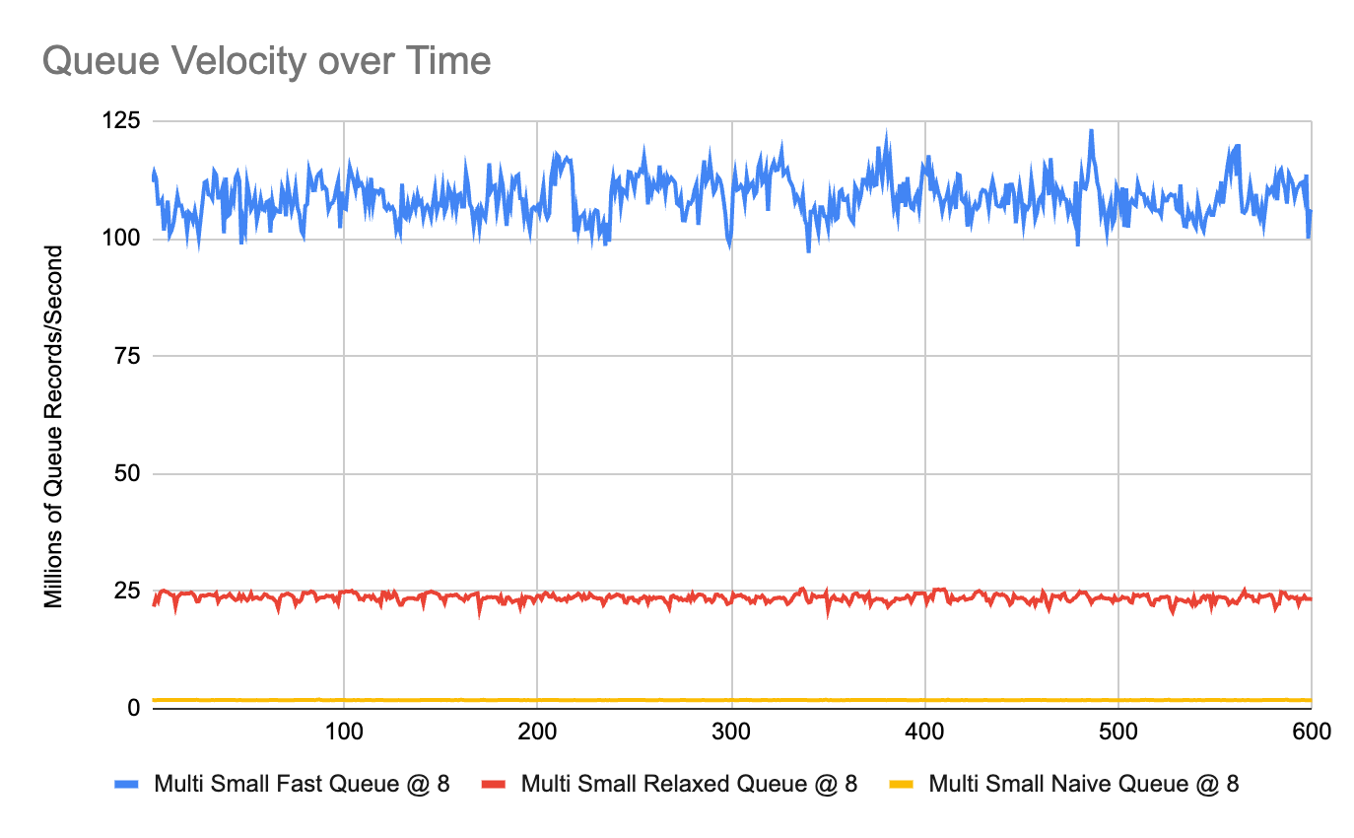

Slide 77
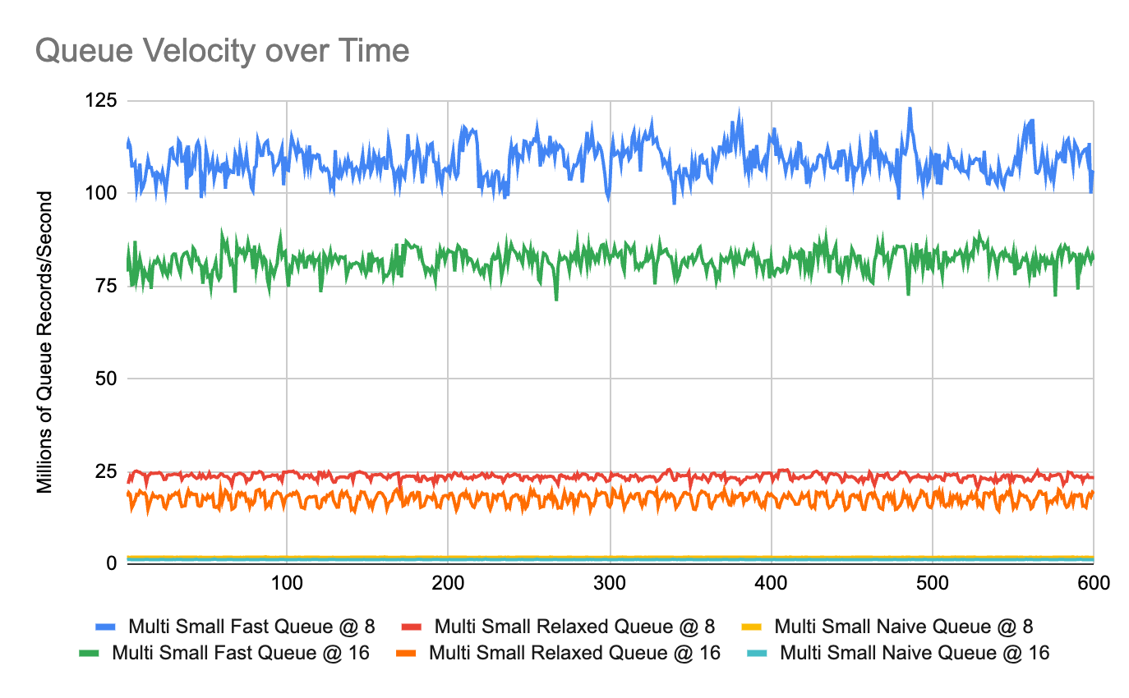

Slide 78
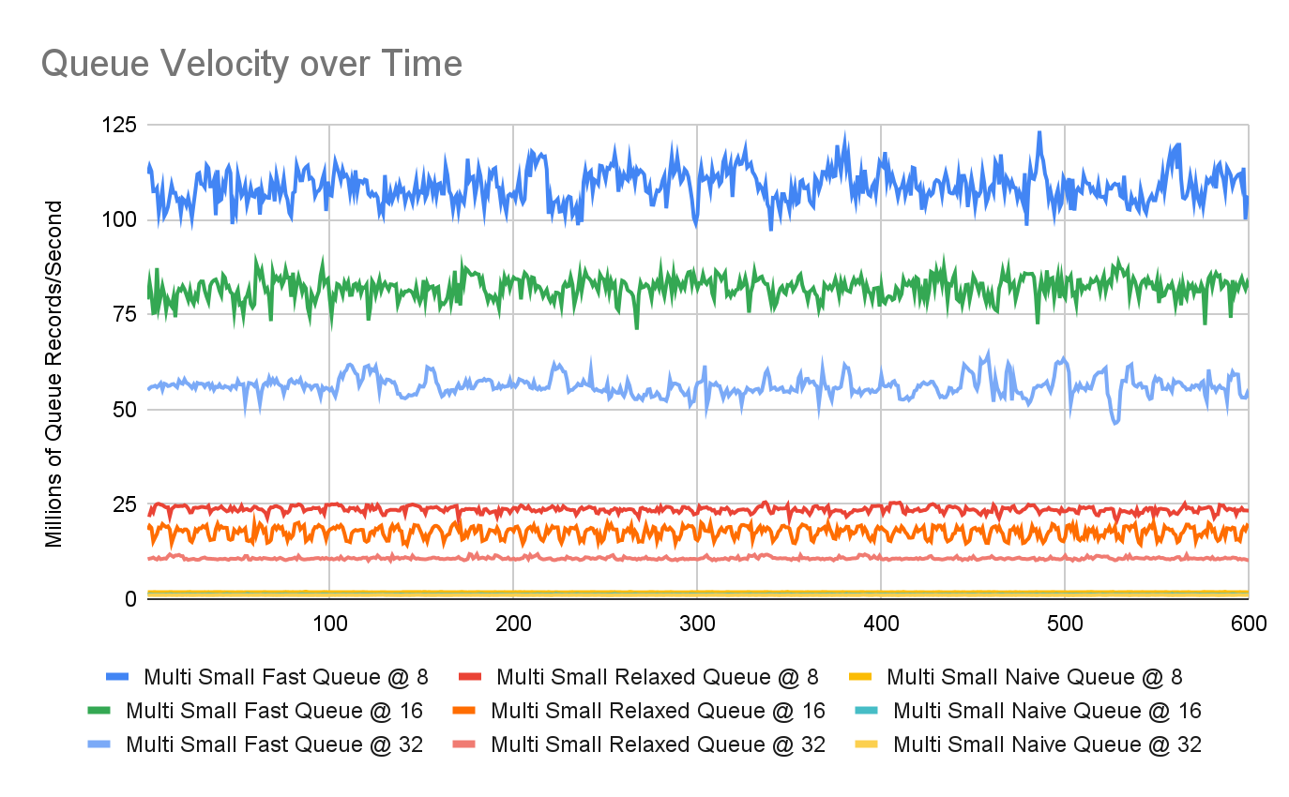

Slide 79
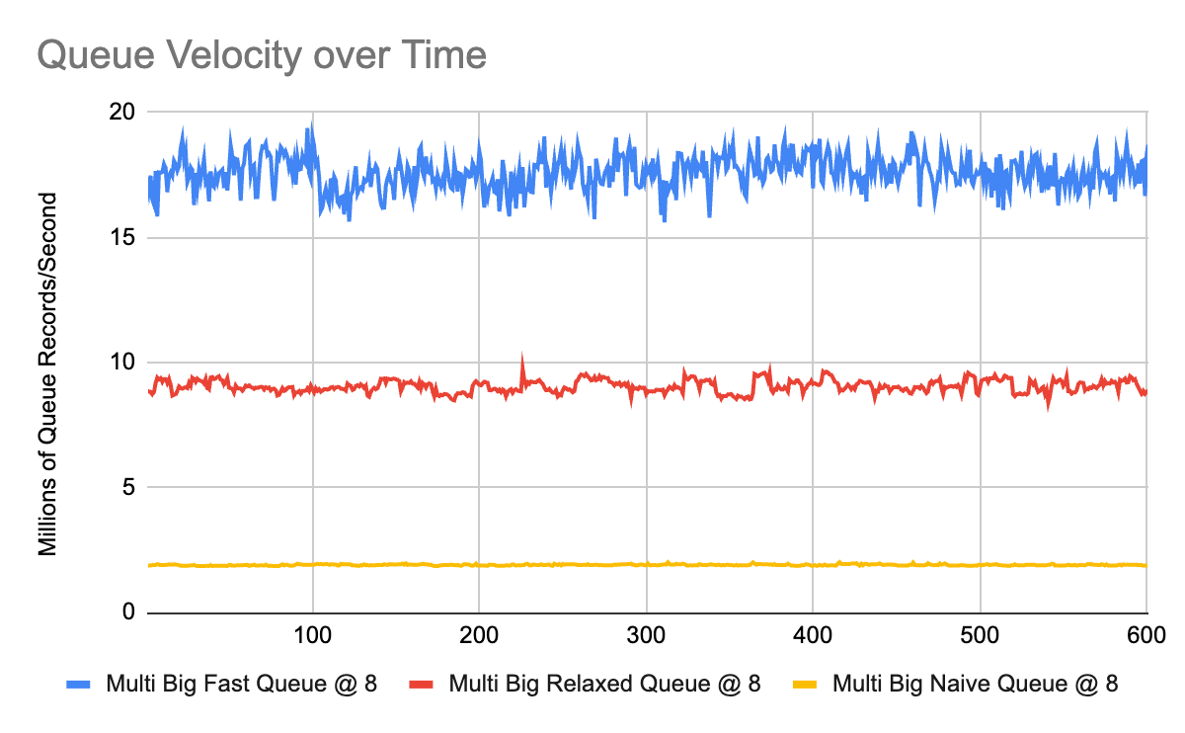

Slide 80
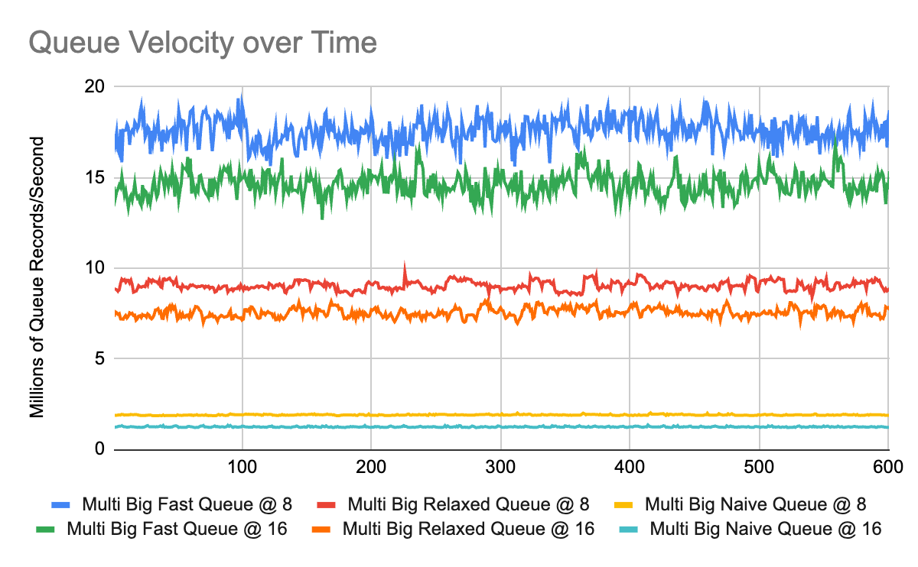

Slide 81
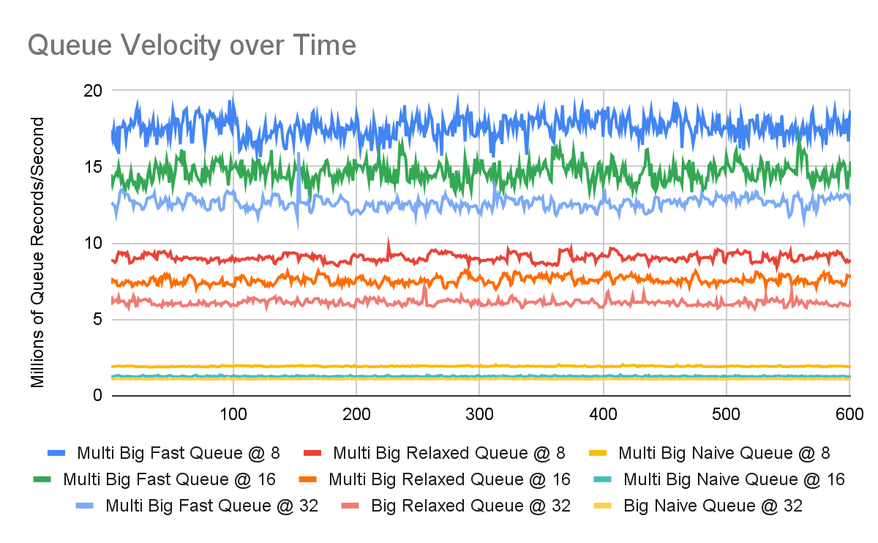

Slide 82
An Interesting Thought
With the acquire/release optimization, this code now issues zero runtime memory fences; Do we actually need to use std::atomic here?
What does it give us?
What happens if we drop it?

Slide 83
Undefined Behavior Queue 😉
// Bad code! Do not use!
struct ubqueue { // Would be a class template in real code, but this is bad code anyways :)
static constexpr std::size_t capacity = 32'768;
static constexpr std::size_t cache_line_size = std::hardware_destructive_interference_size;
ubqueue() : next_producer_record(0), next_consumer_record(0) {}
inline void push(int64_t record) noexcept;
inline int64_t pop() noexcept;
/* details */
alignas(cache_line_size) std::size_t volatile next_producer_record;
alignas(cache_line_size) std::size_t volatile next_consumer_record;
alignas(cache_line_size) std::array<int64_t, num_records> data;
};

Slide 84
Undefined Behavior Queue 😉
inline void ubqueue::push(int64_t record) noexcept {
// Wait until there's space
std::size_t spin_counter = 0;
std::size_t producer = next_producer_record;
while (!has_space(producer)) sleep(spin_counter);
// Produce the record
data[map_index(producer)] = record;
std::atomic_signal_fence(std::memory_order::acq_rel); // load/store compiler fence
next_producer_record = producer + 1;
}

Slide 85
Undefined Behavior Queue 😉
inline int64_t ubqueue::pop() noexcept {
// Wait until there's data
std::size_t spin_counter = 0;
std::size_t consumer = next_consumer_record;
while (!has_data(consumer)) sleep(spin_counter);
// Consume the record
auto record = data[map_index(consumer)];
std::atomic_signal_fence(std::memory_order::acq_rel); // load/store compiler fence
next_consumer_record = consumer + 1;
return record;
}

Slide 86
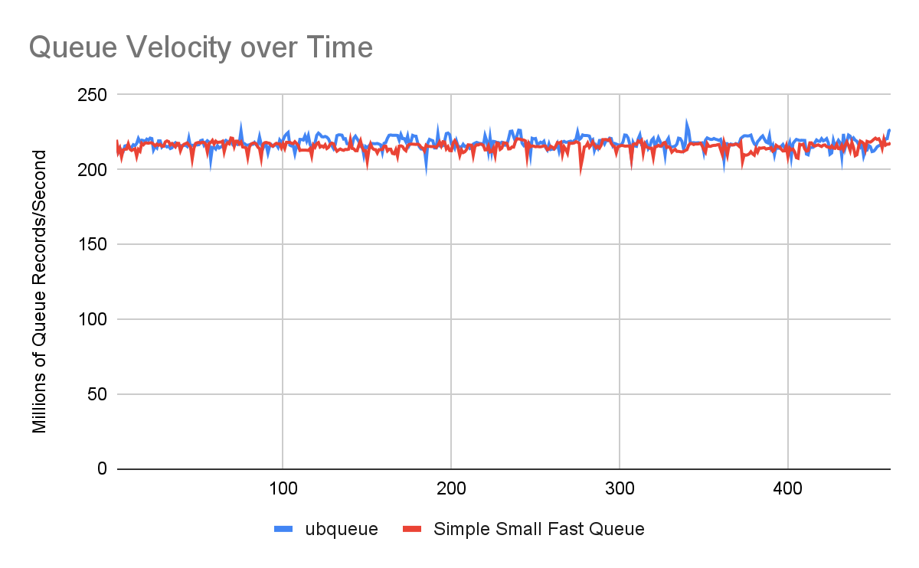

Slide 87
An Interesting Thought
😲 It actually does work, and the performance is essentially identical.
Comparison of the assembly yields essentially the same codegen.
Have we shown that std::atomic is unnecessary?
What happens if we try to run the same code on this laptop? 🤔

Slide 88
An Interesting Thought
cfretz@XF3QVTQ7K6 talk % build/ubqueue
Queue is moving at 0 records/second.
Assertion failed: (val == counter), function consumer, file ubqueue.cc, line 93.
zsh: abort build/ubqueue

Slide 89
An Interesting Thought
Good to know our assertions work 🤣
What went wrong? Why does this work on x86_64, but not on ARM64?

Slide 90
Platform Guarantees
From the Intel x86_64 architecture specification:
Neither Loads Nor Stores Are Reordered with Like Operations
Stores Are Not Reordered With Earlier Loads
Loads May Be Reordered with Earlier Stores to Different Locations
Stores Are Transitively Visible
Stores Are Seen in a Consistent Order by Other Processors

Slide 91
Platform Guarantees
On x86_64, acquire/release semantics are essentially free
This is not true on more weakly-ordered platforms like ARM and PowerPC
ARM requires explicit load-acquire and store-release opcodes to accomplish the same

Slide 92
Atomic Optimization
inline void
ring_buffer::push(int64_t record) noexcept {
// Wait until there's space
std::size_t spin_counter = 0;
std::size_t producer =
next_producer_record.load(
std::memory_order::acquire);
while (!has_space(producer))
sleep(spin_counter);
// Produce the record
data[map_index(producer)] = record;
next_producer_record.store(
producer + 1, std::memory_order::release);
}
.LBB0_1:
and x8, x23, #0x7fff ;; map queue index
str x20, [x21, x8, lsl #3] ;; store rec in queue
add x20, x20, #1 ;; incr curr index
add x8, x23, #1 ;; incr prod index
cmp x20, x22 ;; completion check
stlr x8, [x19] ;; store prod index
b.eq .LBB0_10 ;; producer terminates
.LBB0_2:
add x8, x19, #64
ldar x23, [x19] ;; load prod index
ldar x8, [x8] ;; load consumer index
sub x8, x23, x8 ;; get records in queue
cmp x8, #8, lsl #12 ;; queue capacity check
b.lo .LBB0_1 ;; space is available
mov x24, xzr
b .LBB0_5 ;; nanosleep backoff

Slide 93
Platform Specific Failure
What causes the failure on ARM? What are we missing?
Fence instructions are missing, but why do they matter?
Why do we actually need the fences?

Slide 94
Platform Specific Failure
Does it matter if the producer reads the consumers’ operations out of order?
Does it matter if the producer reads the collector’s operations out of order?
Does it matter if the consumers read the producer’s operations out of order?

Slide 95
Atomic Optimization
inline void
ring_buffer::push(int64_t record) noexcept {
// Wait until there's space
std::size_t spin_counter = 0;
std::size_t producer =
next_producer_record.load(
std::memory_order::acquire);
while (!has_space(producer))
sleep(spin_counter);
// Produce the record
data[map_index(producer)] = record;
next_producer_record.store(
producer + 1, std::memory_order::release);
}
.LBB0_1:
and x8, x23, #0x7fff ;; map queue index
str x20, [x21, x8, lsl #3] ;; store rec in queue
add x20, x20, #1 ;; incr curr index
add x8, x23, #1 ;; incr prod index
cmp x20, x22 ;; completion check
stlr x8, [x19] ;; store prod index
b.eq .LBB0_10 ;; producer terminates
.LBB0_2:
add x8, x19, #64
ldar x23, [x19] ;; load prod index
ldar x8, [x8] ;; load consumer index
sub x8, x23, x8 ;; get records in queue
cmp x8, #8, lsl #12 ;; queue capacity check
b.lo .LBB0_1 ;; space is available
mov x24, xzr
b .LBB0_5 ;; nanosleep backoff

Slide 96
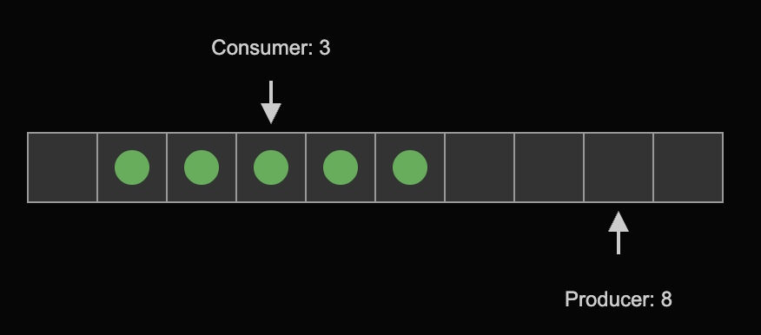
Image generated with ChatGPT 4o Image Gen

Slide 97
Platform Specific Failure
Without the release fence on the producer side, and the acquire fence on the consumer side, the consumer can see the producer move forward before its queue updates are visible.
Consumer then reads junk from the previous iteration.
std::atomic ensures we always get the correct behavior on all platforms.

Slide 98
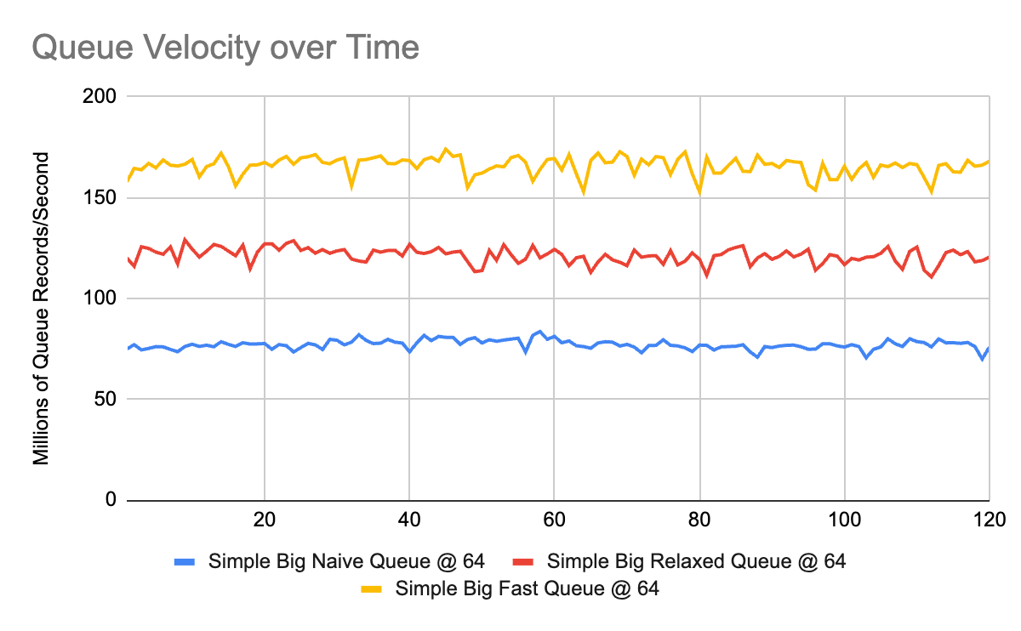

Slide 99
The Final Optimization
Further research encountered this paper published in 2009.
Suggests further optimizing cache performance with the introduction of “cached” indexes for both the producer and consumer.
Adds an additional, cache line aligned, index for both the producer and consumer that holds a previous snapshot of the opposite index.
Cached copies are updated only when the producer/consumer would otherwise need to sleep (cached index appears full/empty).
Resolves the final remaining cause of cache misses for the simple queue.

Slide 100
The Final Optimization
struct ring_buffer { // Would be a class template in real code
static constexpr std::size_t capacity = 32'768;
static constexpr std::size_t cache_line_size = std::hardware_destructive_interference_size;
ring_buffer() : next_producer_record(0), next_consumer_record(0) {}
inline void push(int64_t record) noexcept;
inline int64_t pop() noexcept;
/* details */
alignas(cache_line_size) std::atomic<std::size_t> next_producer_record; // real producer index
alignas(cache_line_size) std::atomic<std::size_t> producer_consumer_cache; // cache of consumer for producer
alignas(cache_line_size) std::atomic<std::size_t> next_consumer_record; // real consumer index
alignas(cache_line_size) std::atomic<std::size_t> consumer_producer_cache; // cache of producer for consumer
alignas(cache_line_size) std::array<int64_t, capacity> data;
};

Slide 101
The Final Optimization
Performance counter stats for 'build/simplesmallfastqueue':
29735927127 L1-dcache-loads:u
1798844339 L1-dcache-load-misses:u # 6.05% of all L1-dcache accesses
664376080 cache-misses:u # 32.238 % of all cache refs
2060853784 cache-references:u
30.300179622 seconds time elapsed
34.977956000 seconds user
0.683142000 seconds sys

Slide 102
The Final Optimization
Performance counter stats for 'build/smalloptimqueue':
87822085858 L1-dcache-loads:u
4410973235 L1-dcache-load-misses:u # 5.02% of all L1-dcache accesses
54422 cache-misses:u # 0.001 % of all cache refs
4431111302 cache-references:u
30.306062641 seconds time elapsed
56.443693000 seconds user
0.125849000 seconds sys

Slide 103
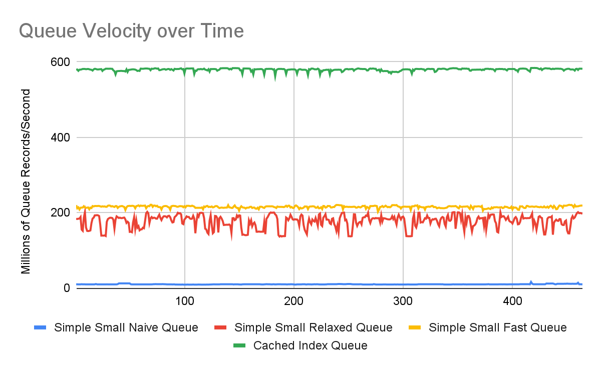

Slide 104
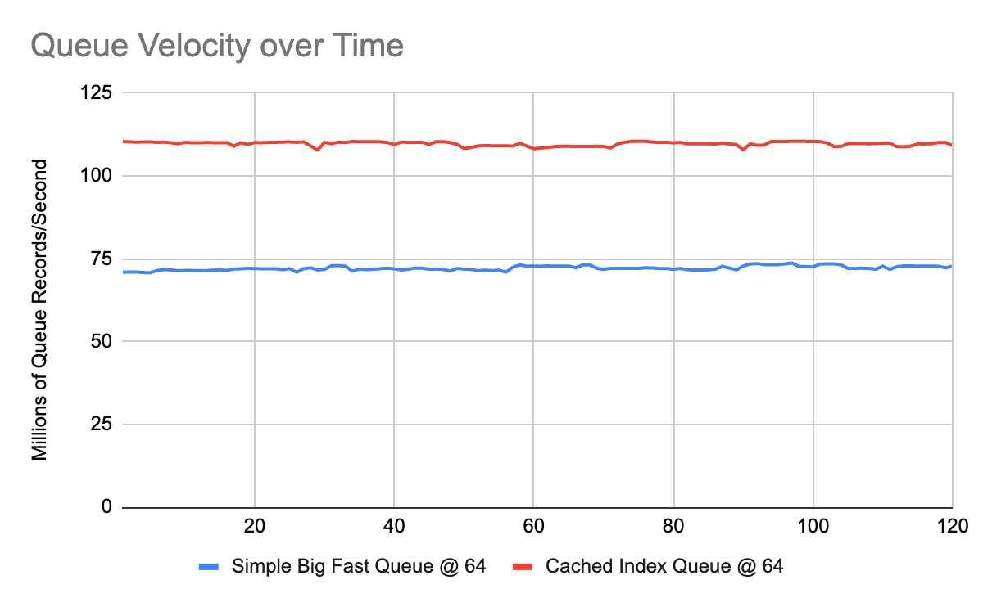

Slide 105
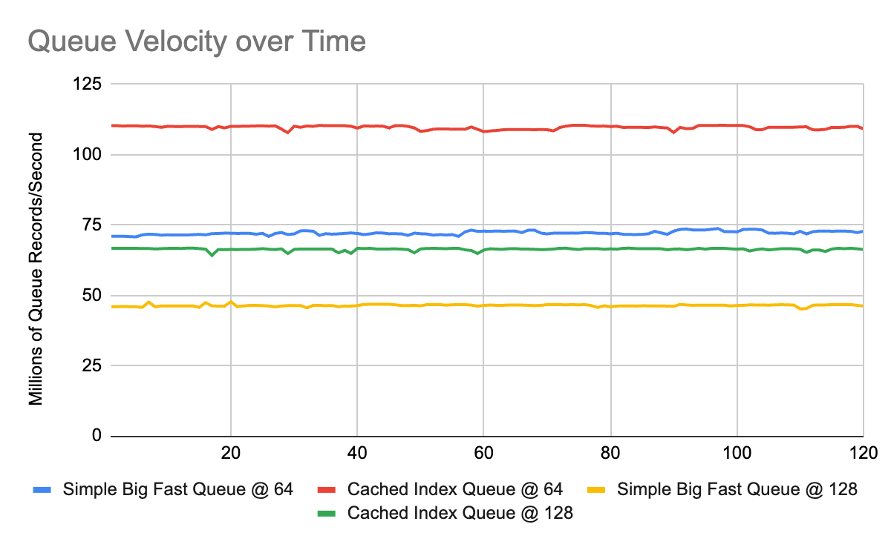

Slide 106
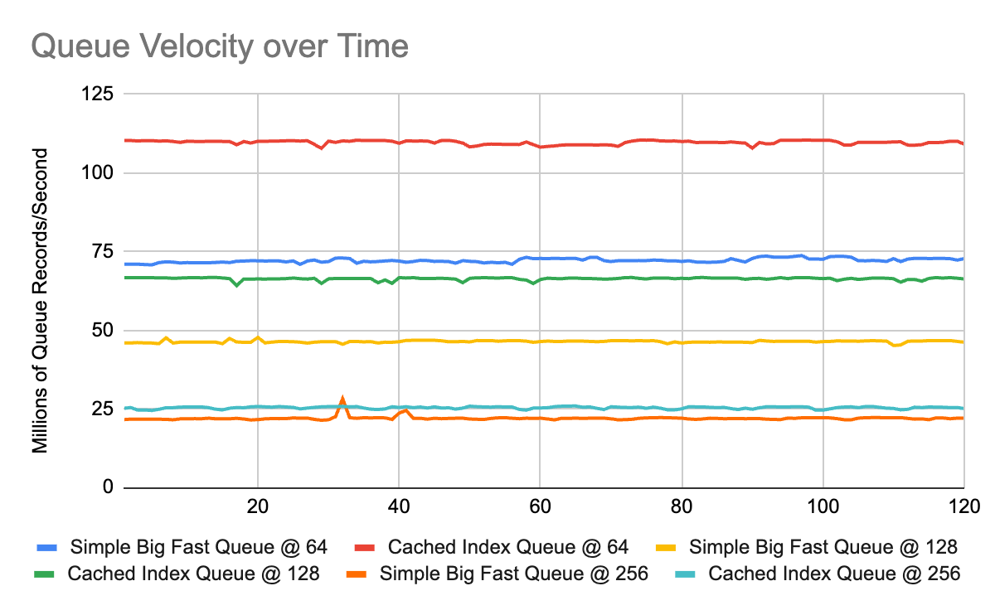

Slide 107
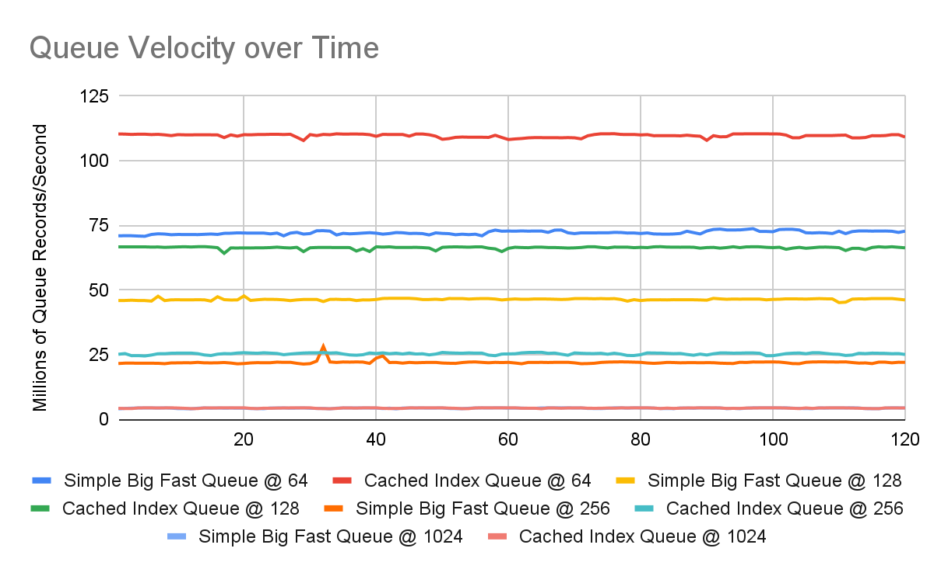

Slide 108
The Final Optimization
🤯
For small queue sizes specifically, optimization makes a massive difference.
Our queue passes integers, a real world use-case would be pointers.
Decays as data sizes get large.
Never seems to perform noticeably worse.
Optimization doesn’t appear to be implemented by either folly or boost.

Slide 109
Final Caveats
This is a data structure that optimizes particularly well.
Performance diff in this case is massive because the data structure is so naturally well aligned with acquire/release semantics.
Often not possible to remove all read-modify-writes.
fetch_add and CAS on x86 always requires a full fence (lock prefix), regardless of what you ask for.
Benchmark!

Slide 110
Surprising Results
Cache line sizes on my M3 Macbook are 128 bytes long
Optimum memory alignment in my testing was 64 bytes; No idea why
AppleClang does not have std::hardware_destructive_interference_size

Slide 111
Conclusions
Using the right model for the job can make a massive difference.
Performance can be hard to reason about; sometimes, it yields surprises.
The standard memory models do an excellent job of ensuring you “can’t write better yourself.”
Relaxed atomics can be difficult to reason about, but can be worth it in the right context.

Slide 112
Thank you!
https://techatbloomberg.com/cplusplus
https://www.bloomberg.com/careers

